Slide 1
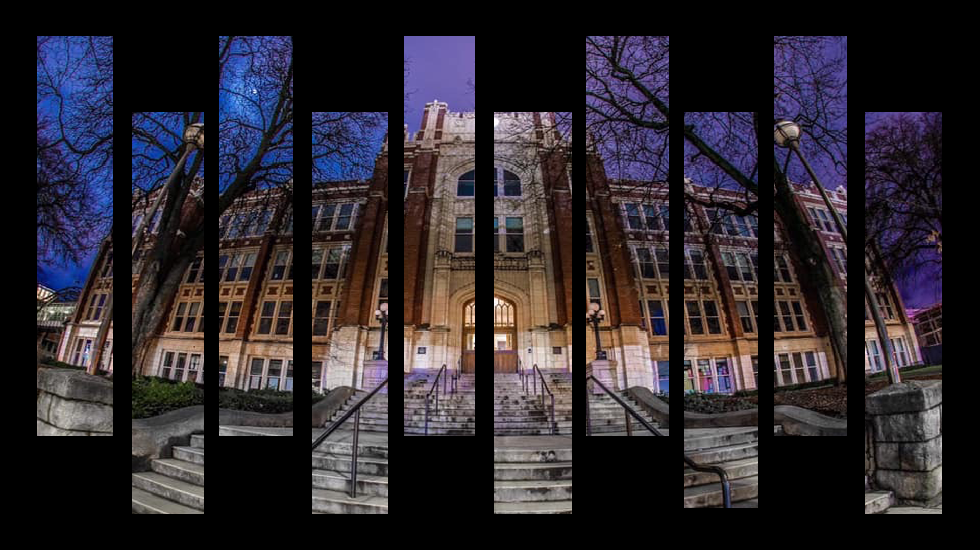
Welcome to
Lewis & Clark High School

Slide 2
ON YOUR REGISTRATION FORM
Neatly print:
LAST name
FIRST name
Student ID #
Middle School
Curie
123456
Marie
Sacajawea

Slide 3
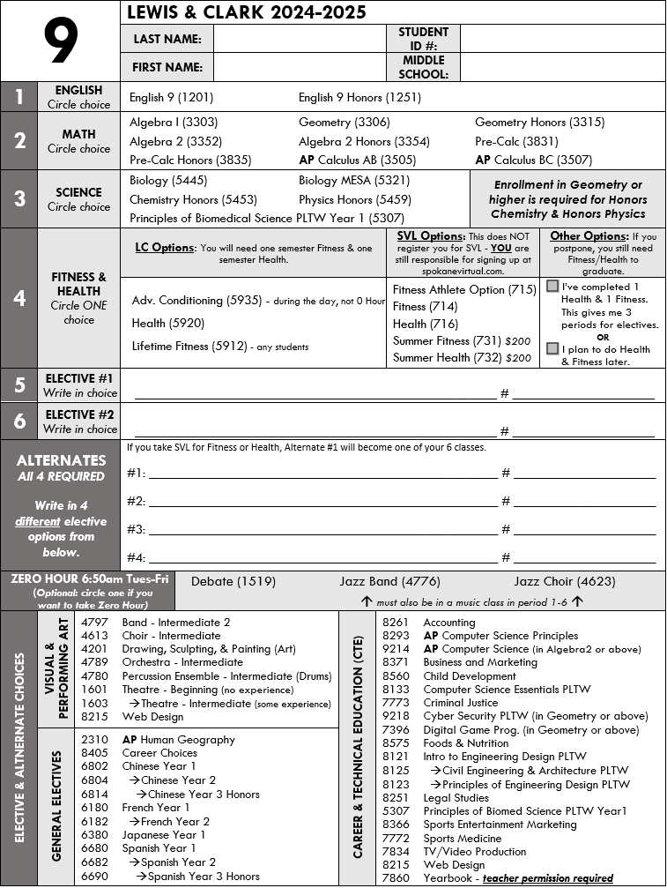
FILLING OUT THE FORM
You must fill out items listed 1-6 AND the 4 required alternates.
Alternates must be different electives from the classes that you listed in 1-6.
Only fill out the optional section if you are choosing to take a zero-hour class.

Slide 4
GRADUATION REQUIREMENTS
Category | 24.0 Required | 24.0+ Recommended
English | 4.0 | 4.0
Social Studies | 3.0 | 3.0
Math | 3.0 | 4.0
Science | 3.0 | 4.0
CTE | 1.0 | 1.0
Health | .5 | .5
Fitness | 1.5 | 1.5
Arts* | 1.0/2.0* | 1.0/2.0*
 | *1.0 credit of Art can be substituted for a Personalized Pathway Elective to support your post-HS plan.
Electives^ | 7.0^ | 5.0^ (+1.0 Math, 1.0 Science)
 | 2.0 (or more) should be focused on your post-HS plan. If your Personalized Pathway is to a 4 Year College, 2.0 of your electives need to be World Language.
Total | 24.0 | 24.0

Slide 5
ENGLISH OPTIONS 4 credits required to graduate
ENGLISH 9 Focus on reading, writing, grammar using the Springboard Curriculum
ENGLISH 9 Honors More sophisticated reading and writing instruction to prepare for AP at 11th/12th grades

Slide 6
MATH OPTIONS 3 credits required, 4 recommended
Algebra
Geometry
Algebra 2
The next step after 8th grade math. If you are earning a C, D, or F in Algebra now, you might want to take Algebra again.
Honors
Geometry
Honors
Algebra 2
After Algebra in 8th grade if you are earning a B or better.
After Geometry in 8th grade if you are earning a B or better.

Slide 7
SCIENCE OPTIONS 3 credits required, 4 recommended
BIOLOGY
Full year of biological plant and animal sciences as a foundation for higher-level science.
MESA BIOLOGY
Same as Biology, but only for girls & students of color. Work with WSU & EWU on special projects.
BIOMEDICAL SCIENCE
Biology taught through the lens of research science with hands-on activities/experiments.
HONORS CHEMISTRY
Strongly suggested that you have taken Algebra in middle school with a B or better. Recommended for general interest in science or a focus on biological sciences.
HONORS PHYSICS
Rigorous advanced option, research project class. Strongly suggested that you have taken Algebra in middle school with a B or better. Recommended for a specific interest in math or engineering.

Slide 8
HEALTH/FITNESS .5 health required; 1.5 fitness required
HEALTH
1 semester class on physical and mental health.
FITNESS/ADVANCED CONDITIONING
1 semester class focusing on creating lifetime fitness habits.
SVL
Online options for health and fitness. If you take these classes in SVL, you will open an additional elective period in your schedule.

Slide 9
SVL is a separate school from LC. If you choose to take an SVL class, you will also need to go online to register. Putting SVL on this form does NOT register you for SVL. (Registration isn’t open yet so keep an eye on the LC News email for updates).
SVL (Online Classes)
SVL classes require you to be organized and self-motivated. You will need to log in every day and complete assignments in order to earn the credit.
Talk to your parents to see if SVL is right for you. Fall SVL classes are free, Summer SVL classes cost $200!

Slide 10
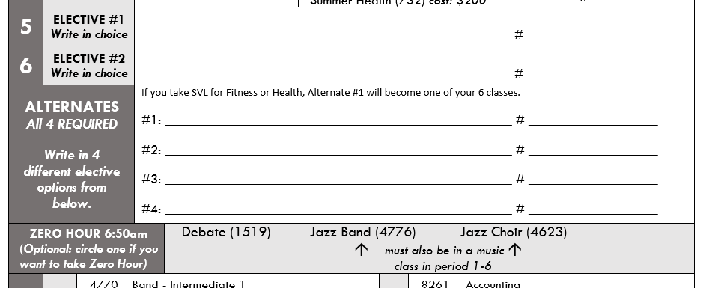
ELECTIVES
7 required
All Electives are full-year courses, you will not change to a new class at semester.
ELECTIVE 1 & 2
These are the primary electives you want to have. We will do our best to give you these 2 classes.
1603
ALTERNATES
You need to select 4 different Alternates in case we cannot get you in the primary electives (space constraints, schedule conflicts, collapsed classes).
Theatre - Intermediate
5307
Biomedical Sciences
7773
Criminal Justice
Chinese Year 1
6802
Intro to Engineering
8121
ZERO HOUR - OPTIONAL
Only fill in this section if you are planning to take a Zero Hour (6:50am start Tues-Fri) class - circle your choice.
Accounting
8261

Slide 11
CTE ELECTIVES
Business: Accounting Business and Marketing Sports Entertainment Marketing Health & Human Services: Child Development Criminal Justice Foods & Nutrition Legal Studies Principles of Biomed Sci PLTW Yr 1 Sports Medicine
Engineering & Technology: Computer Science Essentials PLTW AP Computer Science Principles AP Computer Science (Algebra 2 required) Cyber Security PLTW Digital Game Programming Intro to Engineering Design PLTW Civil Engineering & Architecture PLTW Principles of Engineering Design PLTW TV/Video Production Web Design Yearbook - teacher permission required

Slide 12
ART & GENERAL ELECTIVES
G E N E R A L | AP Human Geography Career Choices Chinese Year 1 Chinese Year 2 Chinese Year 3 Honors French Year 1 French Year 2 Japanese Year 1 Spanish Year 1 Spanish Year 2 Spanish Year 3 Honors
AR T S | Band Choir Drawing, Sculpting, & Painting Orchestra Percussion Ensemble (Drums) Theatre - Beginning Theatre - Intermediate Web Design
Zero Hour | Debate Jazz Band [Art] Jazz Choir [Art]

Slide 13
REGISTERING IN POWERSCHOOL
Log into PowerSchool - go into Clever or https://powerschool.spokaneschools.org/public
Click on the Class Registration icon to begin.
When you are done, do NOT close the program - raise your hand to get approved.

Slide 14
ENTERING YOUR DATA
Click on the little pencil icon for each category
Periods 1-6:
Enter your 6 classes in the order they appear on your form.
Alternates 1-4:
Enter your 4 alternates in the order they appear on your form.
Optional Items:
If you want a Zero Hour and/or SVL - enter it here. Leave these blank if you do not want these classes.

Slide 15
CHOOSING EACH CLASS
For each class, you’ll have a list of all 9th grade classes to choose from in alpha order.
If the class you want isn’t on the first page, use the numbers on the bottom to navigate to the other classes.

Slide 16
When you are finished: 1. Scroll to the bottom 2. Press the SUBMIT button 3. Raise your hand We’ll check you off and collect your form. Do NOT shut your laptop down until you are checked off.

